Slide 1

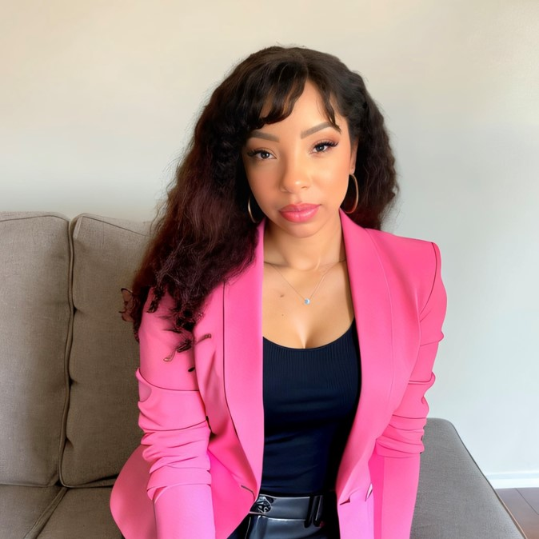
AI-Powered Ad Copy:
Writing Ads That Convert Without Losing The Human Touch
Dii Pooler
PoolerDigital
@diipooler
Poolerdigital.com

Slide 2
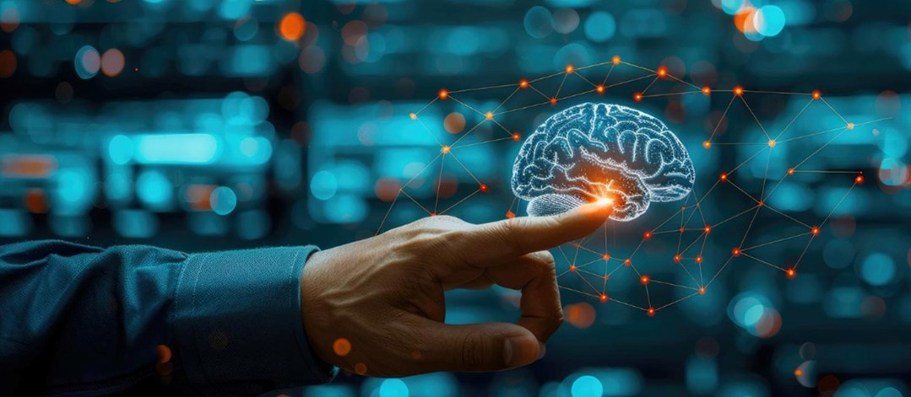
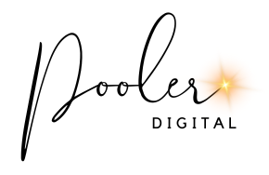
AI-POWERED AD COPY:
WRITING ADS THAT CONVERT WITHOUT LOSING THE HUMAN TOUCH
Mastering the Art of Human-AI Collaboration in PPC
Dii Pooler

Slide 3
THE RISE OF AI IN PPC
Investment in Artificial Intelligence (AI) could reach $200 billion globally by 2025.
Google launches Smart Bidding, using machine learning to optimize bids in real-time.
Jasper.ai gains popularity, offering specialized templates for PPC ad copy.
2016
2023
2025 (Projected)
2010
2018
2024
Google introduces Conversion Optimizer, an early form of automated bidding.
Early AI-powered ad copywriting tools like Persado and Phrasee emerge.
Google introduces AI Overviews in search results, impacting ad placement and visibility.

Slide 4


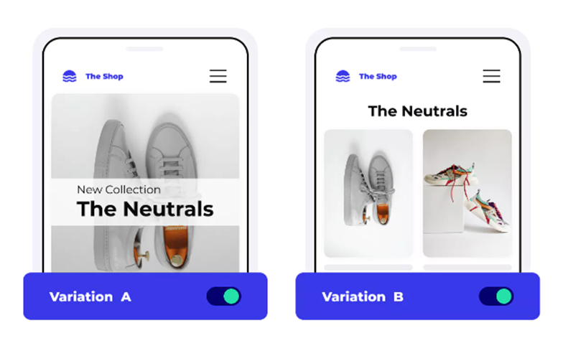
WHY USE AI FOR PPC AD COPY?
Increased Efficiency
Improved Targeting
Enhanced Performance

Slide 5
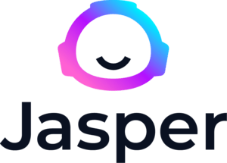
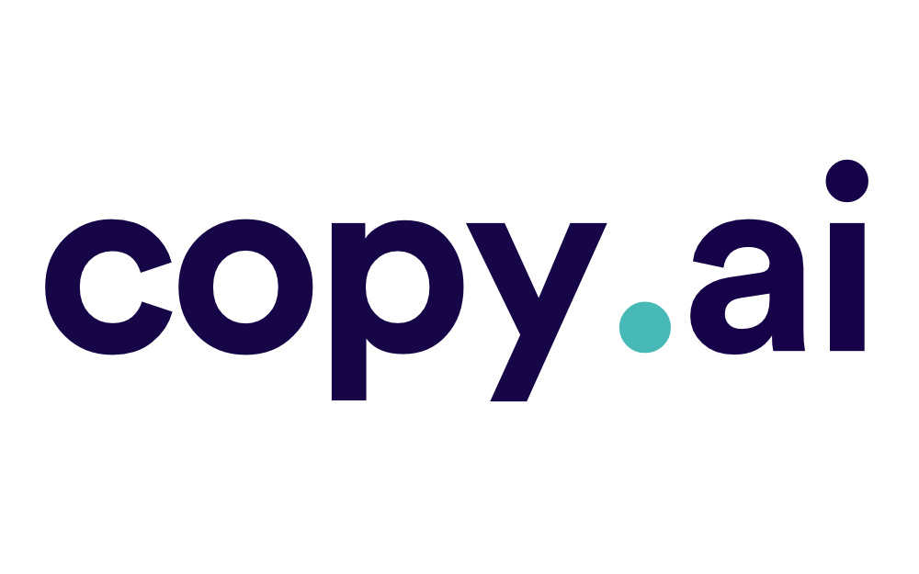








YOUR AI-POWERED COPYWRITING ARSENAL
Tools That Make You a PPC Superhero

Slide 6




AI Privacy Compliance
Know your tools: Are they compliant with data privacy regulations?
Establish clear guidelines: What data can be used? What's off-limits? Is your CISO / CLO / DPA on board?
Survey & Train your team: Ensure everyone understands the risks and best practices.
Stay informed: The AI landscape is constantly evolving, so keep up!

Slide 7
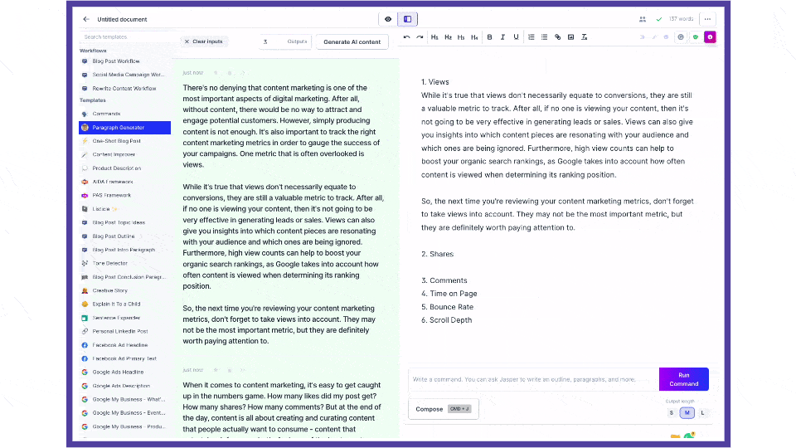
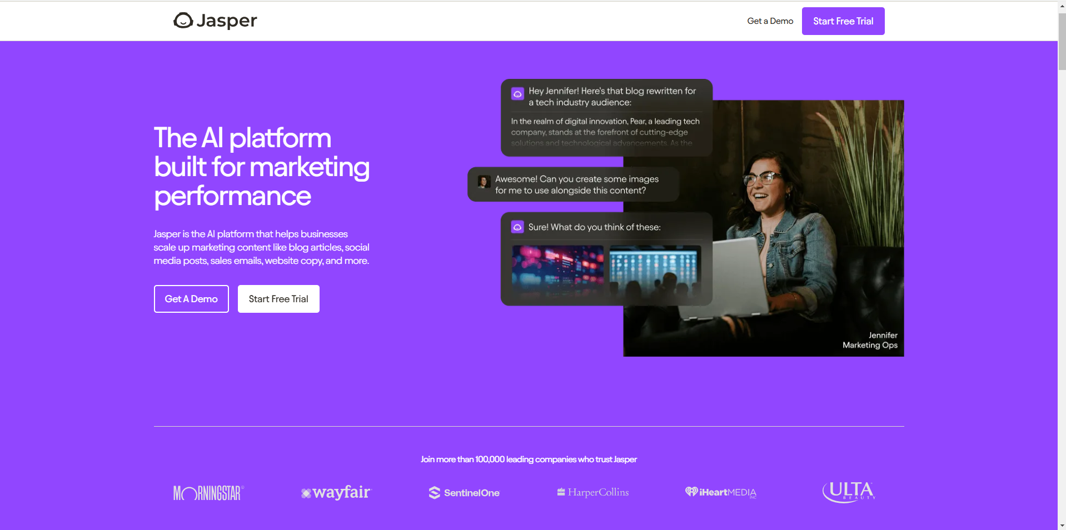
JASPER - AI-POWERED AD COPY TOOL

Slide 8
JASPER - AI-POWERED AD COPY TOOL
Intuitive Interface
AI-Driven Suggestions
Templates for Ad Copy
Advanced Language Support
Tone Customization
Content Optimization

Slide 9
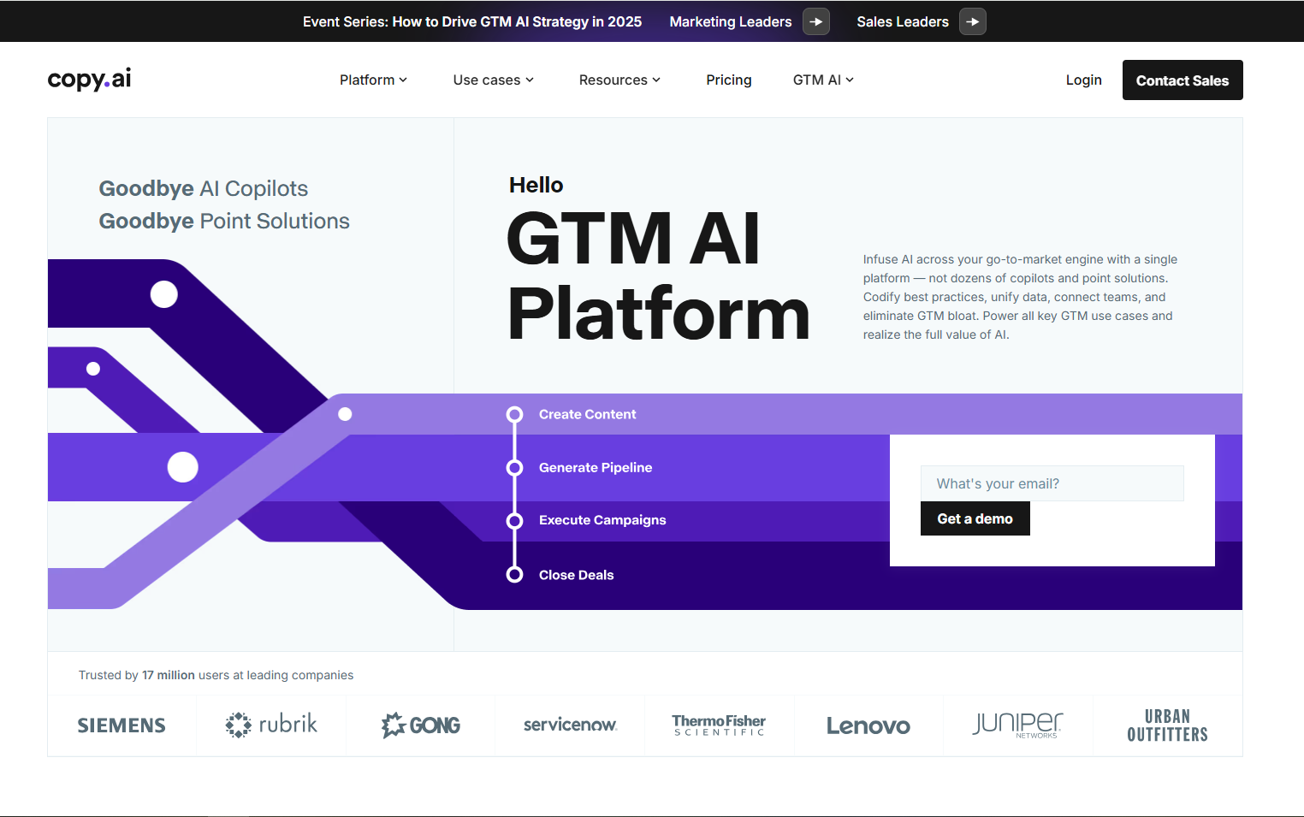
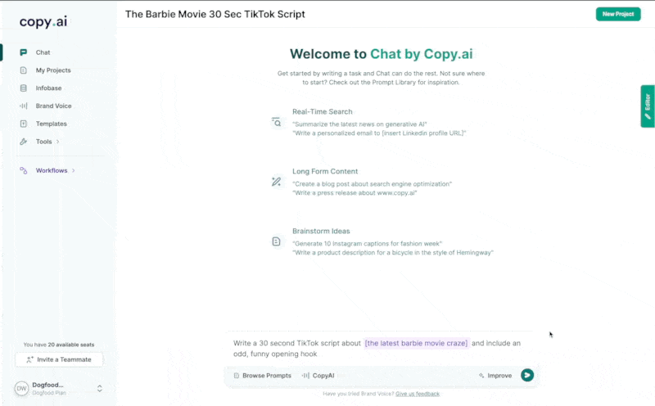
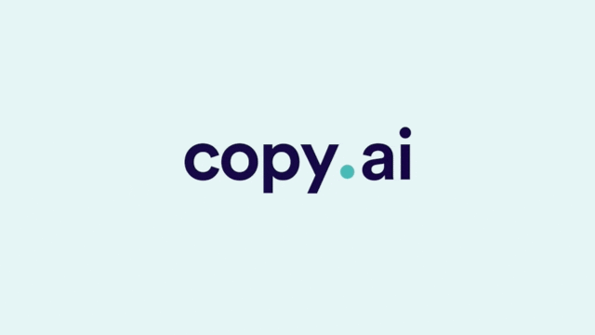
COPY.AI - FAST AND CREATIVE AD WRITING

Slide 10
COPY.AI - FAST AND CREATIVE AD WRITING
User-Friendly Interface
Variety of Templates
Auto-Suggestions
Customizable Tone
and Style
Speed and Efficiency
Collaboration Tools

Slide 11

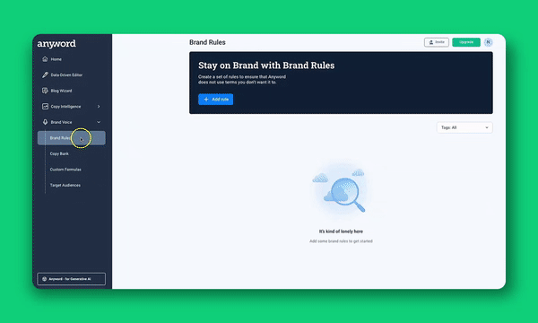
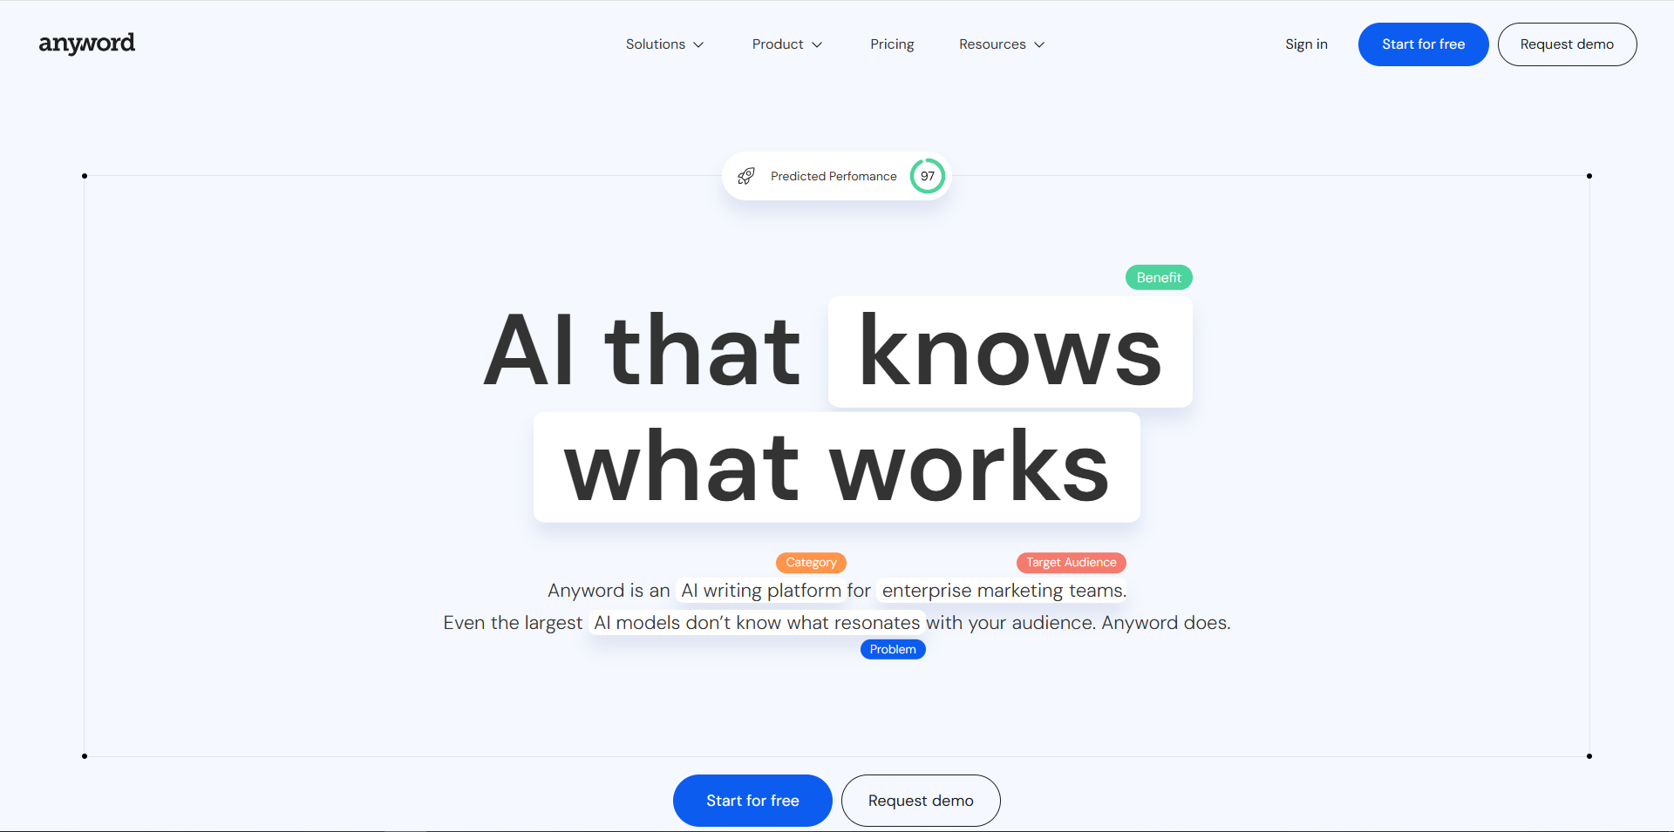

ANYWORD - DATA-DRIVEN AD COPY GENERATOR

Slide 12
ANYWORD - DATA-DRIVEN AD COPY GENERATOR
Predictive Performance Scoring
Targeted Messaging
A/B Testing Variants
Platform-Specific Tools
Conversion-Focused Language
Audience Personas

Slide 13
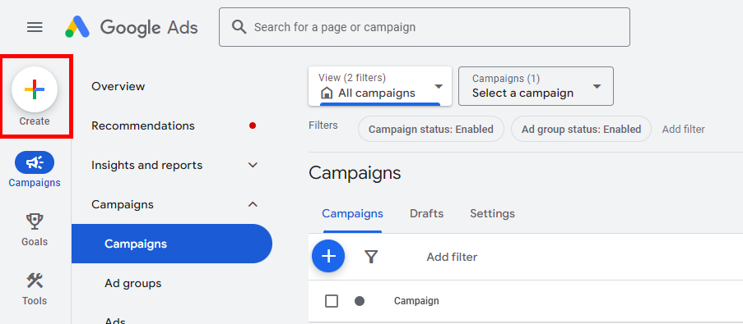
AI Platform Google Ads Test:
30/days for a Professional Development Brand
ChatGPT
Jasper
Copy.AI
Anyword
ChatGPT + Human Customization
Human Written Content

Slide 14
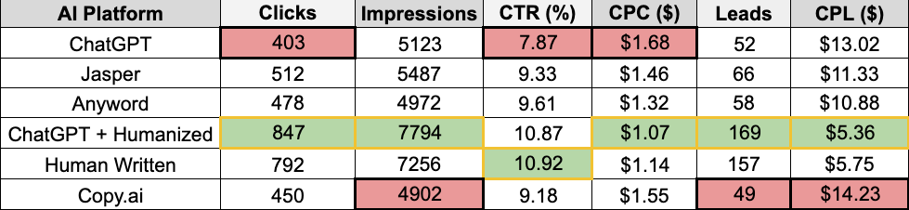
AI Platform Google Ads Test:
30/days for a Professional Development Brand
ChatGPT + Humanization Outperforms!

Slide 15

THE ESSENTIAL HUMAN TOUCH: WHY AND HOW TO HUMANIZE AI-GENERATED
Before (AI-generated):
After (Humanized):
Don't Let Your Ads Sound Like a Robot Wrote Them!
"Our software helps businesses grow. Try it today!"
"Is your sales team having trouble turning prospects into customers? Our software equips your team with powerful, intuitive tools to close deals faster and build lasting client relationships. Try it free!"
(Generic, lacks emotion)
(More specific, addresses pain points, uses stronger language)

Slide 16
THE ESSENTIAL HUMAN TOUCH: WHY AND HOW TO HUMANIZE AI-GENERATED
Why Humanize?
Connect with audiences on an emotional level, build trust, and drive conversions.
Don't Let Your Ads Sound Like a Robot Wrote Them!
How to Humanize:
Infuse emotional appeal, tell stories, use vivid language.
Vary sentence structure, use active voice.
Incorporate figurative language.
Remove AI "tics" and generic phrases, use Trends

Slide 17
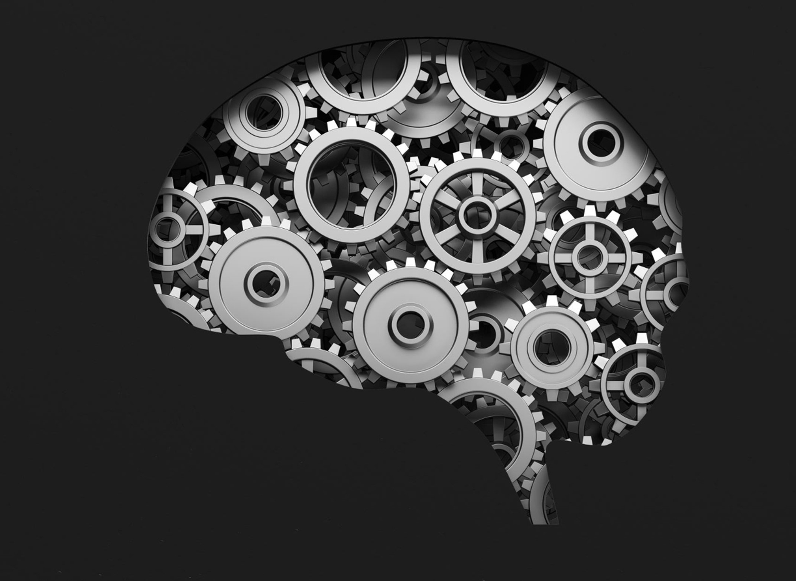
TAKING HUMANIZATION TO THE NEXT LEVEL
Advanced Techniques for Humanizing AI Output;
AI Persona

Slide 18

PROMPT ENGINEERING: THE ART OF TALKING TO AI
Understanding LLMs
Clear and Concise Communication
Iterative Prompt Development
Persona and Tone Design
Contextual Awareness
Temperature Control
Prompt Chaining
Retrieval-Augmented Generation
Evaluation and Refinement
Ethical Considerations

Slide 19
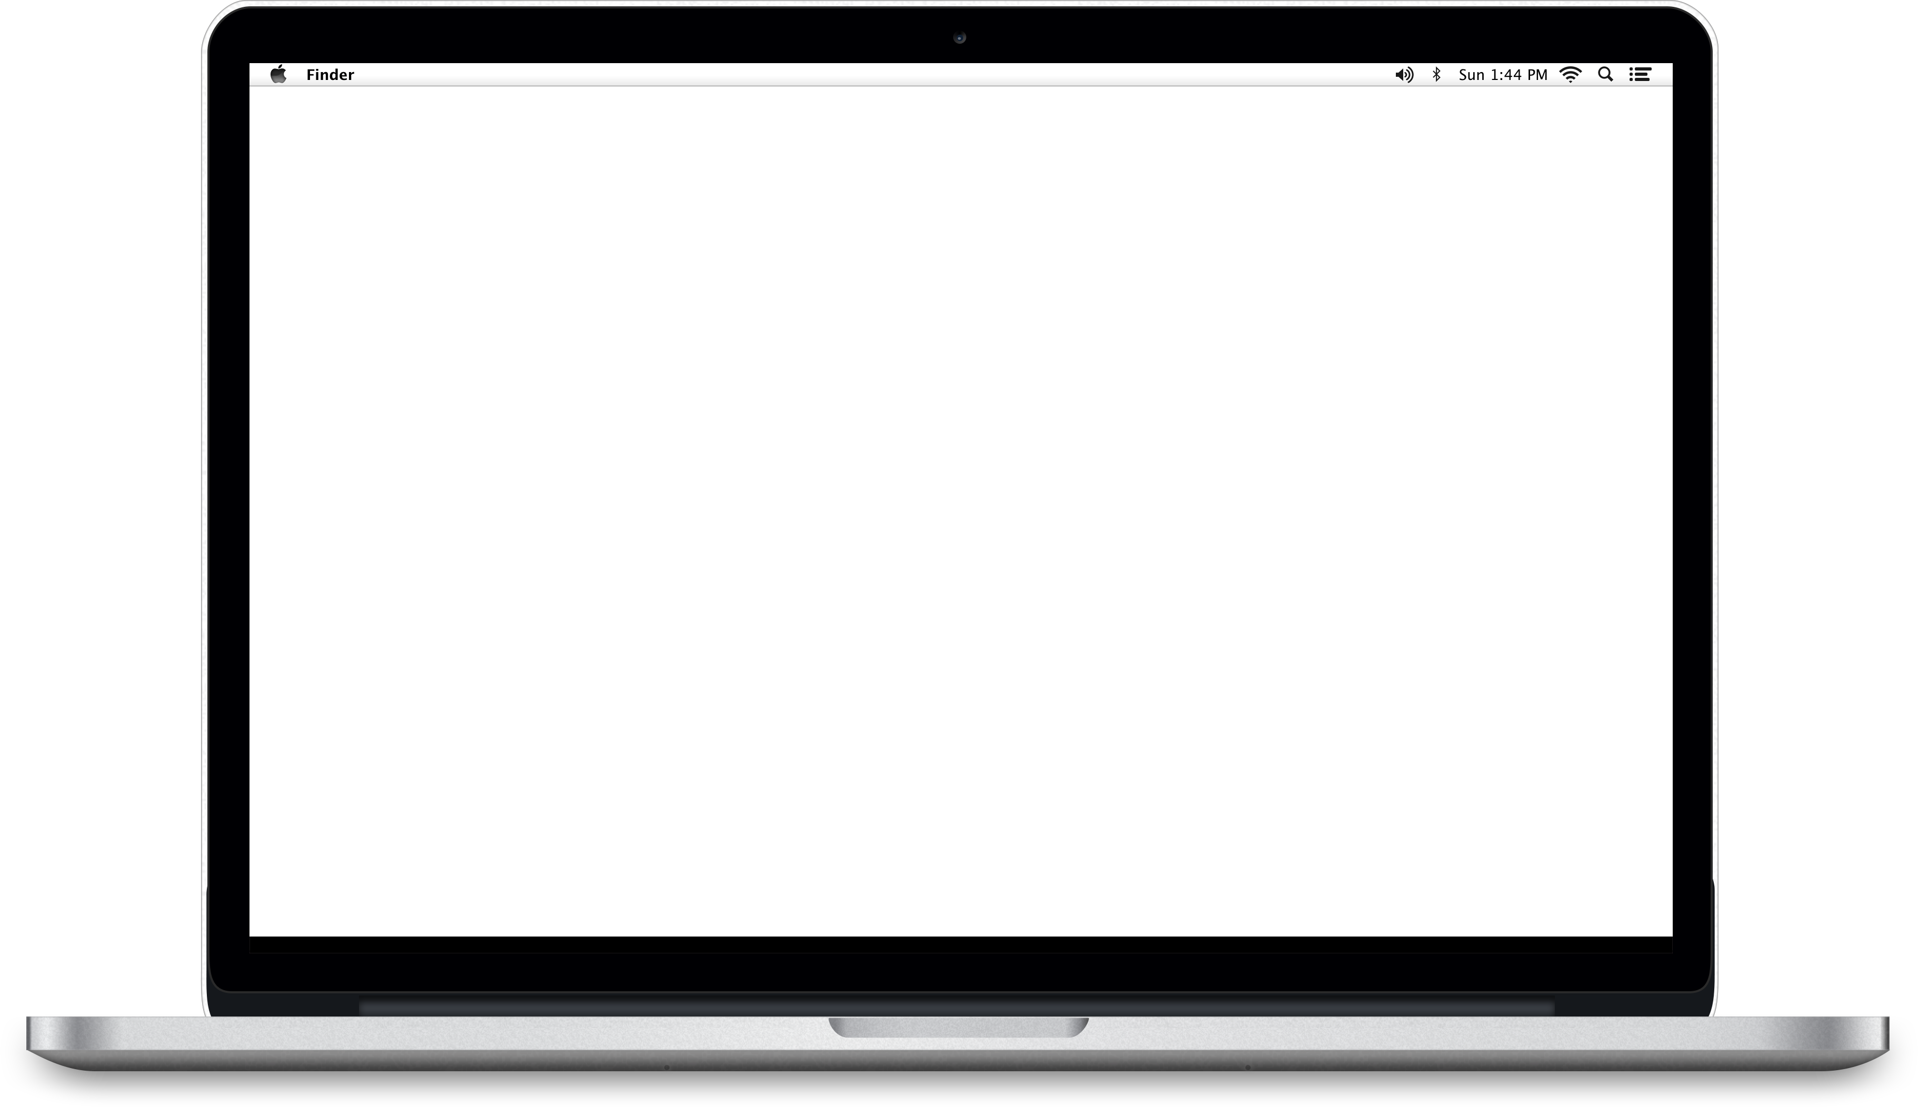



PUTTING PROMPT ENGINEERING INTO PRACTICE
Examples Of Prompts For
"Act as a Facebook Ads expert with 10 years of experience who utilizes ad copy writing best practices from [source 1], [source 2], and [source 3] to attract [target customer] who'd be interested in completing a lead form for [product] for [business]. This customer's pain points are usually [pain points], and we solve them by [solution]. The ad copy needs to be [x] characters long. Please provide 10 unique variations."
…
Example of an "Act as a..." prompt:
Message AI

Slide 20
PUTTING PROMPT ENGINEERING INTO PRACTICE
Well Researched Material
"Act as a Facebook Ads expert with 10 years of experience who utilizes ad copy writing best practices from [source 1], [source 2], and [source 3] to attract [target customer] who'd be interested in completing a lead form for [product] for [business]. This customer's pain points are usually [pain points], and we solve them by [solution]. The ad copy needs to be [x] characters long. Please provide 10 unique variations."
…
Message AI

Slide 21
PUTTING PROMPT ENGINEERING INTO PRACTICE
Well Researched Material
"Act as a Facebook Ads expert with 10 years of experience who utilizes ad copy writing best practices from [source 1], [source 2], and [source 3] to attract [target customer] who'd be interested in completing a lead form for [product] for [business]. This customer's pain points are usually [pain points], and we solve them by [solution]. The ad copy needs to be [x] characters long. Please provide 10 unique variations."
Only Reliable & Up To Date
…
Message AI

Slide 22
PUTTING PROMPT ENGINEERING INTO PRACTICE
Well Researched Material
"Act as a Facebook Ads expert with 10 years of experience who utilizes ad copy writing best practices from [source 1], [source 2], and [source 3] to attract [target customer] who'd be interested in completing a lead form for [product] for [business]. This customer's pain points are usually [pain points], and we solve them by [solution]. The ad copy needs to be [x] characters long. Please provide 10 unique variations."
Only Reliable & Up To Date
Summarize & Analyze
…
Message AI

Slide 23
PUTTING PROMPT ENGINEERING INTO PRACTICE
Well Researched Material
"Act as a Facebook Ads expert with 10 years of experience who utilizes ad copy writing best practices from [source 1], [source 2], and [source 3] to attract [target customer] who'd be interested in completing a lead form for [product] for [business]. This customer's pain points are usually [pain points], and we solve them by [solution]. The ad copy needs to be [x] characters long including spaces. Please provide 10 unique variations."
Only Reliable & Up To Date
Summarize & Analyze
…
Q/A Test
Message AI

Slide 24
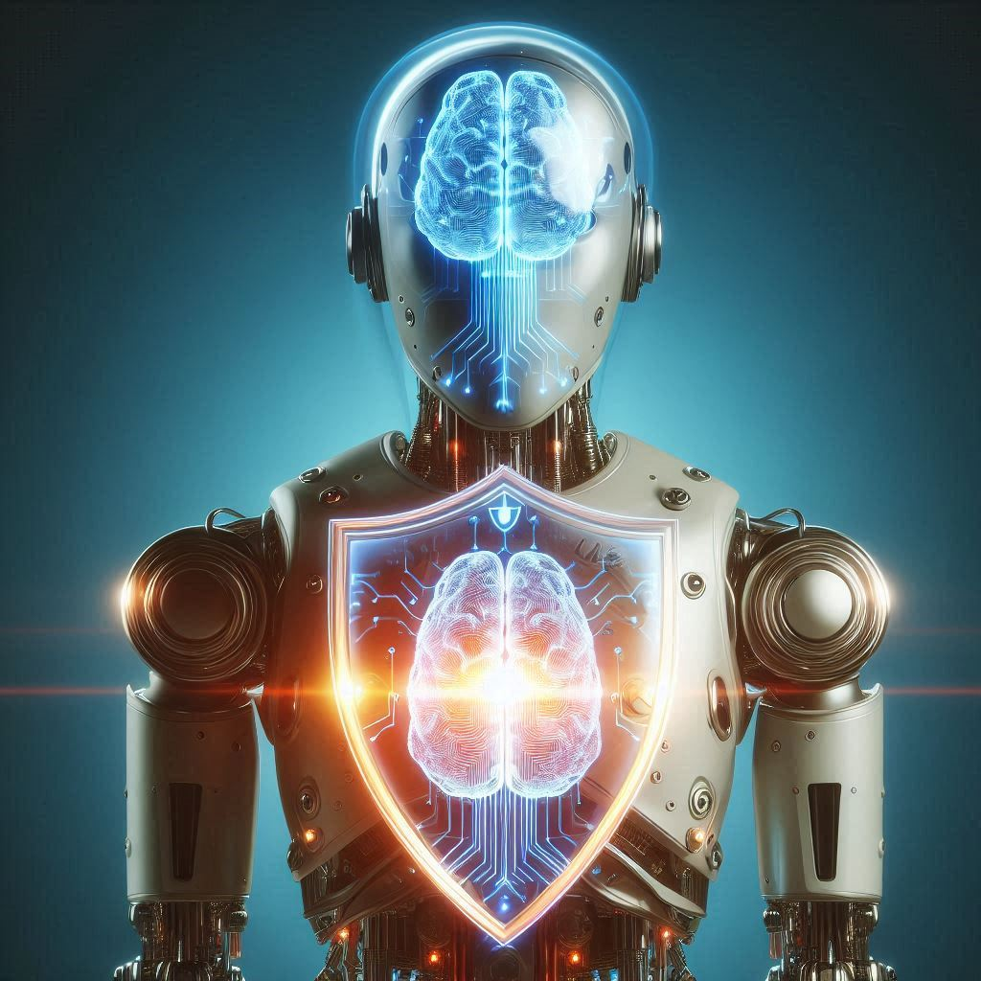
NAVIGATING THE ETHICAL LANDSCAPE OF AI IN PPC
Responsible AI Use
The Evolving Landscape
Human-AI Collaboration

Slide 25
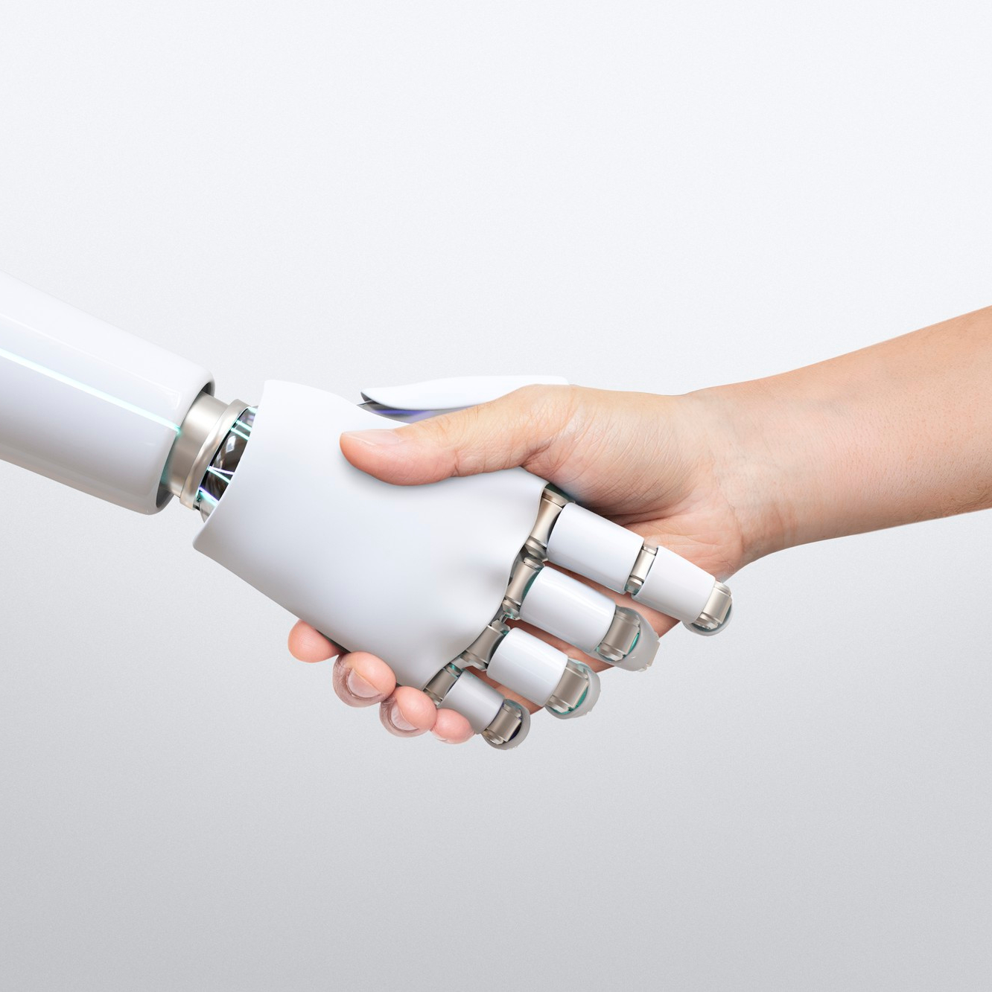
THE FUTURE IS NOW: EMBRACE THE POWER OF HUMAN-AI COLLABORATION
AI is a powerful ally, not a replacement
Humanization is key
Embrace continuous learning
Master prompt engineering
Always bring your human touch to the table.

Slide 26
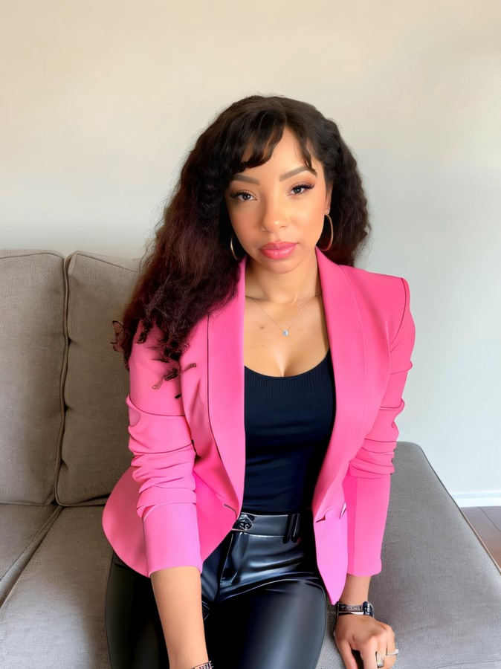
THANK YOU!
Questions?
Dii Pooler
https://www.poolerdigital.com/
www.linkedin.com/in/diipooler

